Slide 1


CS 430/536
Computer Graphics I
Polygon Clipping and Filling
Week 3, Lecture 5
David Breen, William Regli and Maxim Peysakhov
Geometric and Intelligent Computing Laboratory
Department of Computer Science
Drexel University
http://gicl.cs.drexel.edu

Slide 2
Outline
Polygon clipping
  Sutherland-Hodgman,
  Weiler-Atherton
Polygon filling
  Scan filling polygons
  Flood filling polygons
Introduction and discussion of homework #2

Slide 3
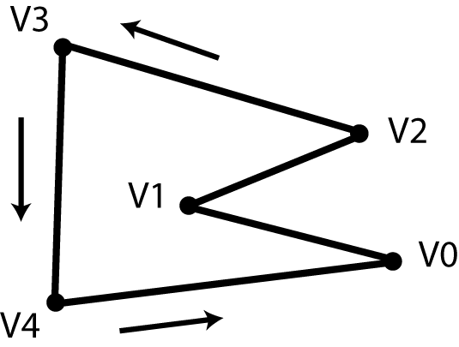
Polygon
Ordered set of vertices (points)
  Usually counter-clockwise
Two consecutive vertices define an edge
Left side of edge is inside
Right side is outside
Last vertex implicitly connected to first
In 3D vertices are co-planar

Slide 4
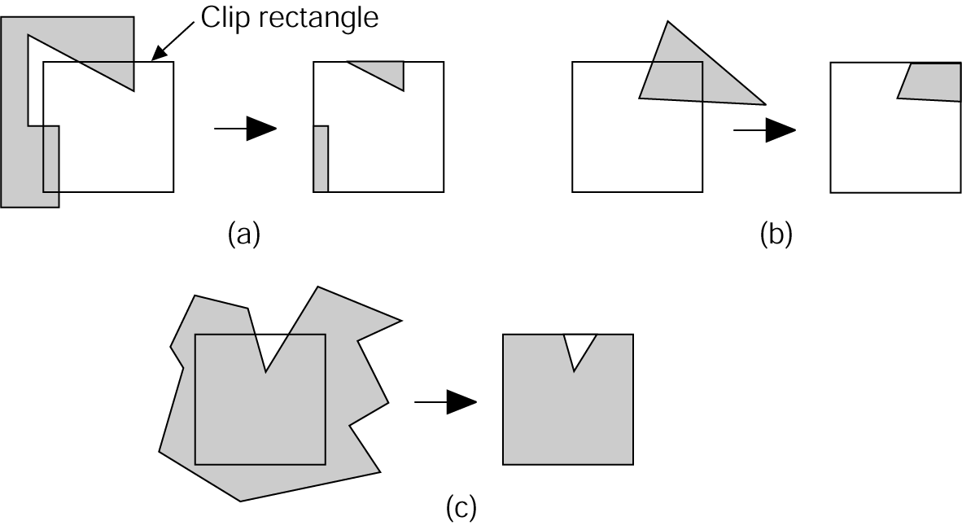
Polygon Clipping
Lots of different cases
Issues
  Edges of polygon need
  to be tested against
  clipping rectangle
  May need to add new edges
  Edges discarded or divided
  Multiple polygons can result from a single polygon
1994 Foley/VanDam/Finer/Huges/Phillips ICG

Slide 5
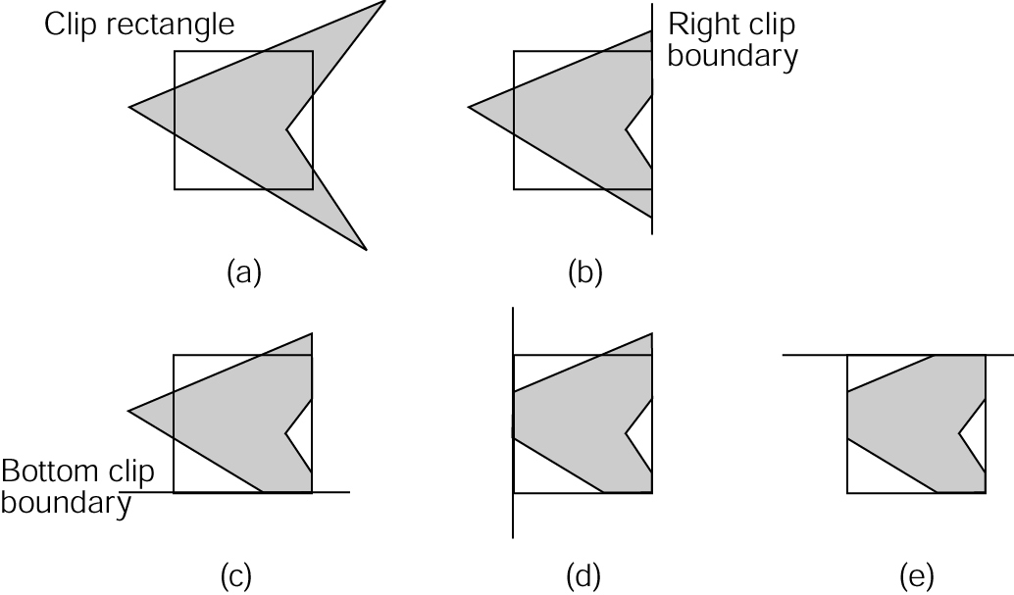
The Sutherland-Hodgman Polygon-Clipping Algorithm
Divide and Conquer
Idea:
  Clip single polygon using
  single infinite clip edge
  Repeat 4 times
Note the generality:
  2D convex n-gons can clip arbitrary n-gons
  3D convex polyhedra can clip arbitrary polyhedra
1994 Foley/VanDam/Finer/Huges/Phillips ICG

Slide 6
Sutherland-Hodgman Algorithm
Input:
  v₁, v₂, … v_{n} the vertices defining the polygon
  Single infinite clip edge w/ inside/outside info
Output:
  v’₁, v’₂, … v’_{m}, vertices of the clipped polygon
Do this 4 (or n_{e}) times
Traverse vertices (edges)
Add vertices one-at-a-time to output polygon
  Use inside/outside info
  Edge intersections

Slide 7
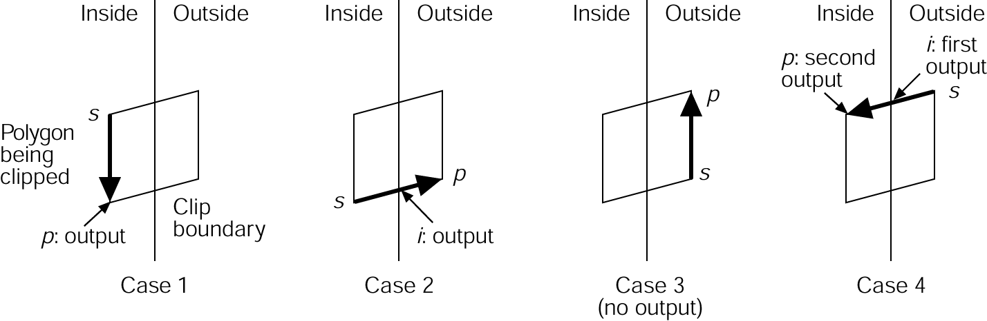
Sutherland-Hodgman Algorithm
Can be done incrementally
If first point inside add. If outside, don’t add
Move around polygon from v₁ to v_{n} and back to v₁
Check v_{i},v_{i+1} wrt the clip edge
Need v_{i},v_{i+1}‘s inside/outside status
Add vertex one at a time. There are 4 cases:
1994 Foley/VanDam/Finer/Huges/Phillips ICG

Slide 8
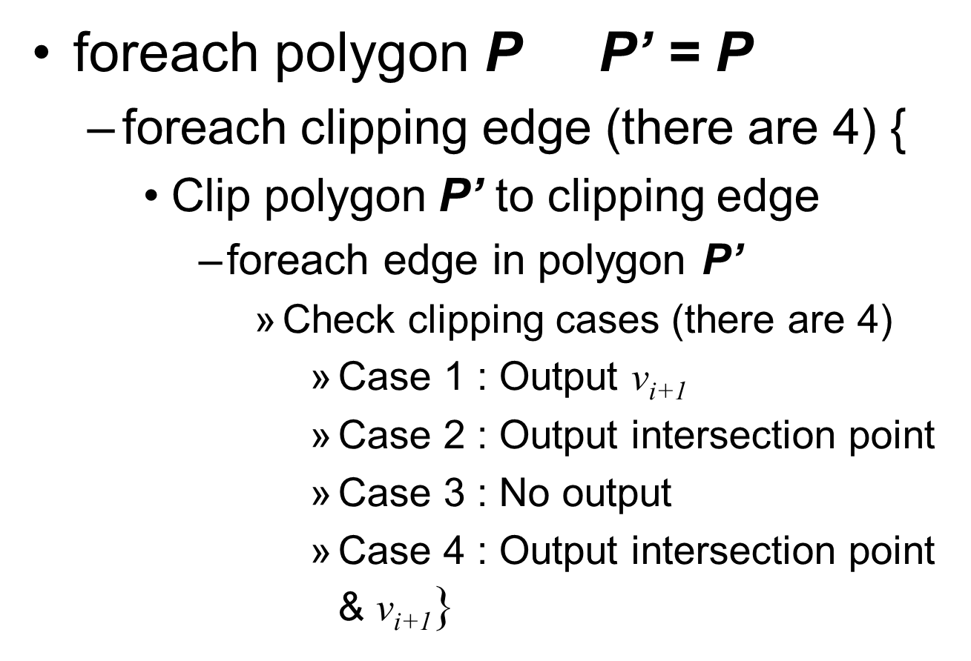
Sutherland-Hodgman Algorithm

Slide 9
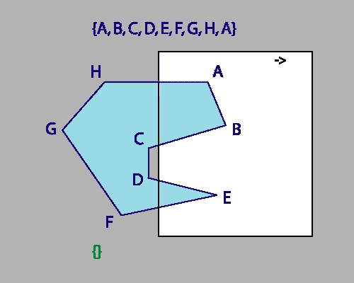
Sutherland-Hodgman Algorithm
Animated by Max Peysakhov @ Drexel University

Slide 10
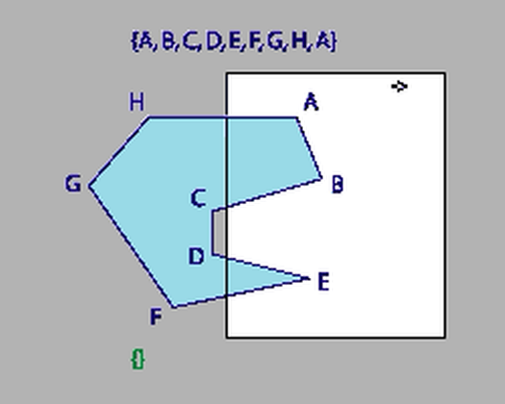
Sutherland-Hodgman Algorithm
Animated by Max Peysakhov @ Drexel University

Slide 11
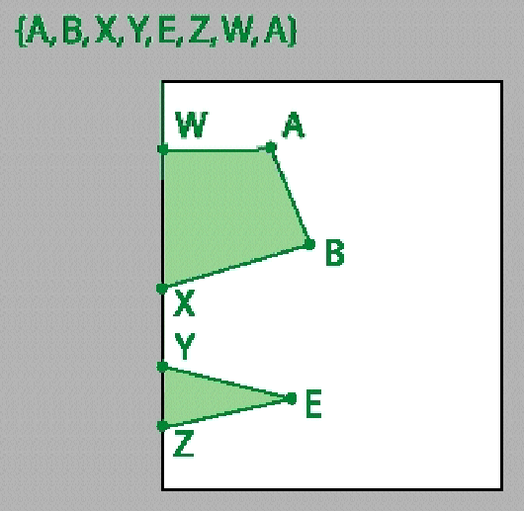
Final Result
Note: Edges XY and ZW!

Slide 12
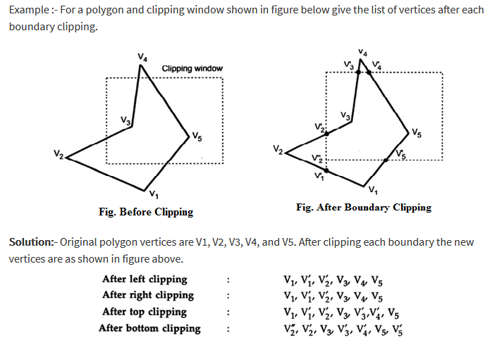

Slide 13
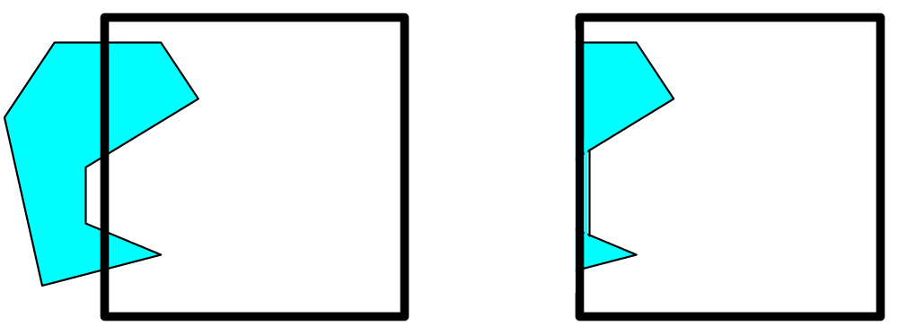
Issues with Sutherland-Hodgman Algorithm
Clipping a concave polygon
Can produce two CONNECTED areas
1994 Foley/VanDam/Finer/Huges/Phillips ICG

Slide 14
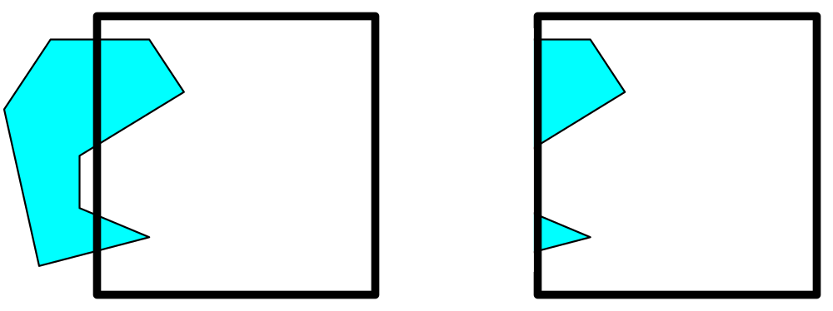
Weiler-Atherton Algorithm
General clipping algorithm for concave polygons with holes
Produces multiple polygons (with holes)
Make linked list data structure
Traverse to make new polygon(s)
1994 Foley/VanDam/Finer/Huges/Phillips ICG

Slide 15
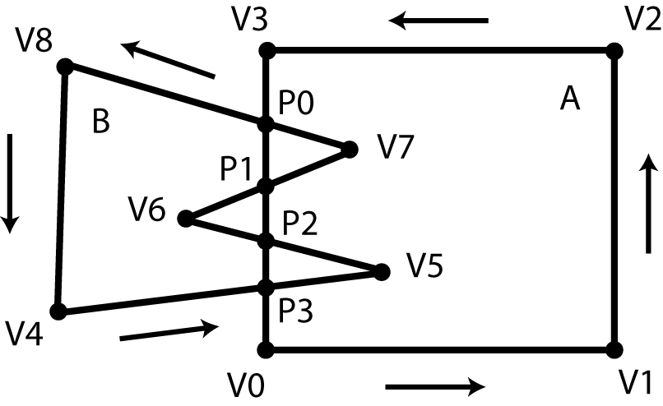
Weiler-Atherton Algorithm
Given polygons A and B as linked list of vertices (counter-clockwise order)
Find all edge intersections & place in list
Insert as “intersection” nodes
Nodes point to A & B
Determine in/out
status of vertices

Slide 16
Intersection Special Cases
If “intersecting” edges are parallel, ignore
Intersection point is a vertex
  Vertex of A lies on a vertex or edge of B
  Edge of A runs through a vertex of B
  Replace vertex with an intersection node

Slide 17
Weiler-Atherton Algorithm: Union
Find a vertex of A outside of B
Traverse linked list
At each intersection point switch to other polygon
Do until return to starting vertex
All visited vertices and nodes define union’ed polygon

Slide 18
Weiler-Atherton Algorithm: Intersection
Start at intersection point
  If connected to an “inside” vertex, go there
  Else step to an intersection point
  If neither, stop
Traverse linked list
At each intersection point switch to other polygon and remove intersection point from list
Do until return to starting intersection point
If intersection list not empty, pick another one
All visited vertices and nodes define and’ed polygon

Slide 19
Boolean Special Cases
If polygons don’t intersect
  Union
    If one inside the other, return polygon that surrounds the other
    Else, return both polygons
  Intersection
    If one inside the other, return polygon inside the other
    Else, return no polygons

Slide 20
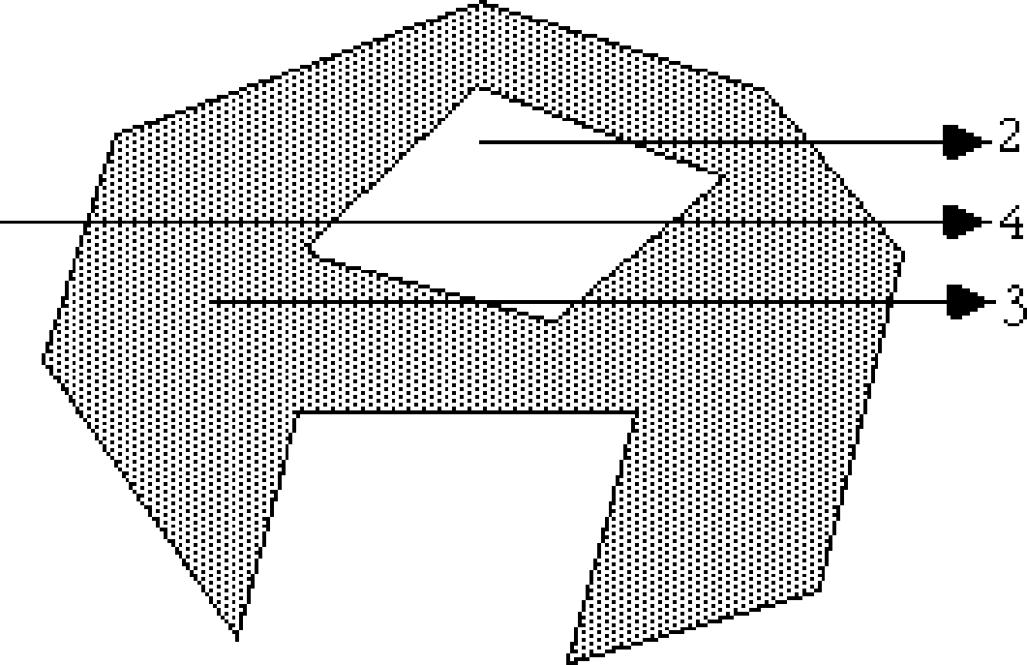
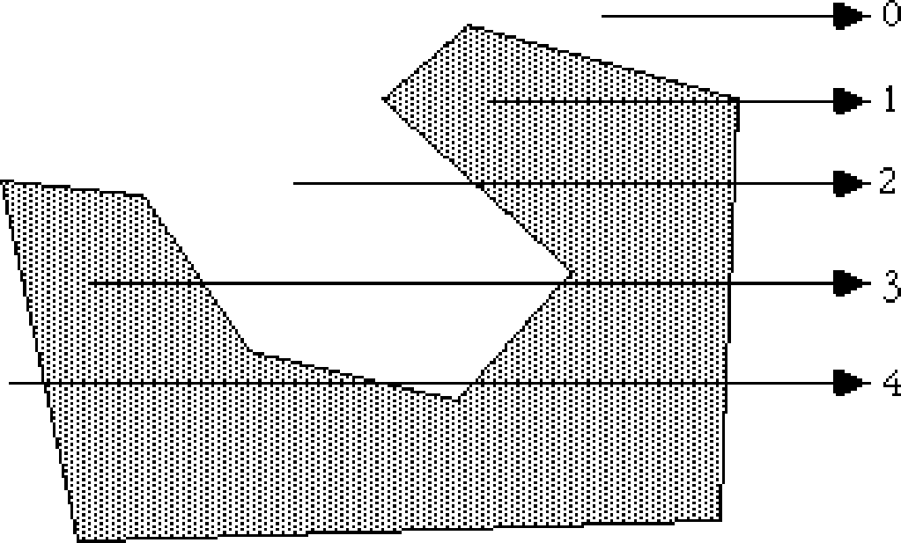
Point P Inside a Polygon?
Connect P with another point P` that you know is outside polygon
Intersect segment PP` with polygon edges
Watch out for vertices!
If # intersections is even (or 0)  Outside
If odd  Inside

Slide 21
Edge clipping
Re-use line clipping from HW1
  Similar triangles method
  Cyrus-Beck line clipping
Yet another technique

Slide 22
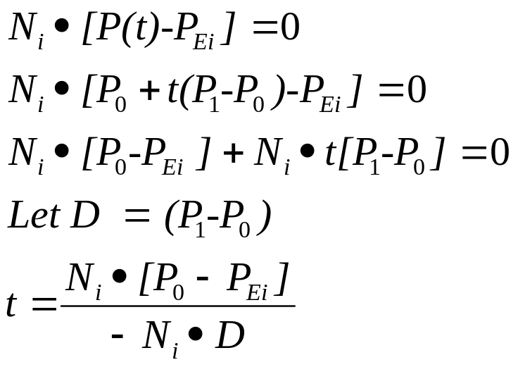
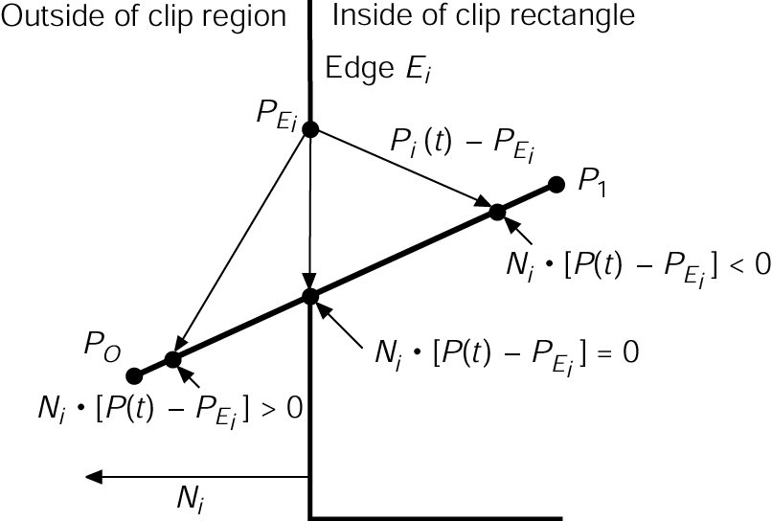
Do two edges intersect?
Cyrus-Beck Algorithm
Line P(t) = P₀ +t(P₁-P₀)
Point on the edge P_{Ei}
Make sure
D ≠ 0, or P₁ ≠ P₀
N_{i}• D ≠ 0, i.e. lines are not parallel
Is 0 ≤ t ≤ 1 for both edges?
1994 Foley/VanDam/Finer/Huges/Phillips ICG

Slide 23
Calculating N_{i}
N_{i} for window edges
WT: (0,1) WB: (0, -1) WL: (-1,0) WR: (1,0)
N_{i} for arbitrary edges
Calculate edge direction
  E = (V₁ - V₀) / |V₁ - V₀|
  Be sure to process edges in CCW order
Rotate direction vector -90°
  N_{x} = E_{y}
  N_{y} = -E_{x}

Slide 24
Calculating N_{i}
Calculate edge direction
  E = (V₁ - V₀) / |V₁ - V₀|
  Be sure to process edges in CCW order
Rotate direction vector -90°
  N_{x} = E_{y}
  N_{y} = -E_{x}

Slide 25
Intersecting Two Edges (1)
Edge 0 : (P₀,P₁)
Edge 2 : (P₂,P₃)
E₀ = P₀ + t₀∗(P₁-P₀) D₀ ≡ (P₁-P₀)
E₂ = P₂ + t₂∗(P₃-P₂) D₂ ≡ (P₃-P₂)
P₀ + t₀∗D₀ = P₂ + t₂∗D₂
x₀ +dx₀ ∗ t₀ = x₂ +dx₂ ∗ t₂
y₀ +dy₀ ∗ t₀ = y₂ +dy₂ ∗ t₂

Slide 26
Intersecting Two Edges (2)
Solve for t’s
t₀ = ((x₀ - x₂) ∗ dy₂+ (y₂ - y₀) ∗ dx₂) /
(dy₀ ∗ dx₂- dx₀ ∗ dy₂)
t₂ = ((x₂ - x₀) ∗ dy₀+ (y₀ - y₂) ∗ dx₀) /
(dy₂ ∗ dx₀- dx₂ ∗ dy₀)
See http://www.vb-helper.com/howto_intersect_lines.html for derivation
Edges intersect if 0 ≤ t₀,t₂ ≤ 1
Edges are parallel if denominator = 0

Slide 27
Filling Primitives: Rectangles, Polygons & Circles
Two part process
  Which pixels to fill?
  What values to fill them with?
Idea: Coherence
  Spatial: pixels are the
  same from pixel-to-pixel
  and scan-line to scan line;
  Span: all pixels on a span get the same value
  Scan-line: consecutive scan lines are the same
  Edge: pixels are the same along edges

Slide 28
Scan Filling Primitives: Rectangles
Easy algorithm
  Fill from x_{min} to x_{max}
  Fill from y_{min} to y_{max}
Issues
  What if two adjacent
  rectangles share an edge?
  Color the boundary pixels twice?
  Rules:
    Color only interior pixels
    Color left and bottom edges

Slide 29
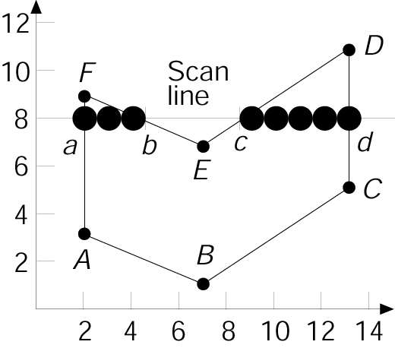
Scan Filling Primitives: Polygons
Observe:
  FA, DC intersections are integer
  FE, ED intersections are not integer
For each scan line, how to figure out which pixels are inside the polygon?
1994 Foley/VanDam/Finer/Huges/Phillips ICG

Slide 30
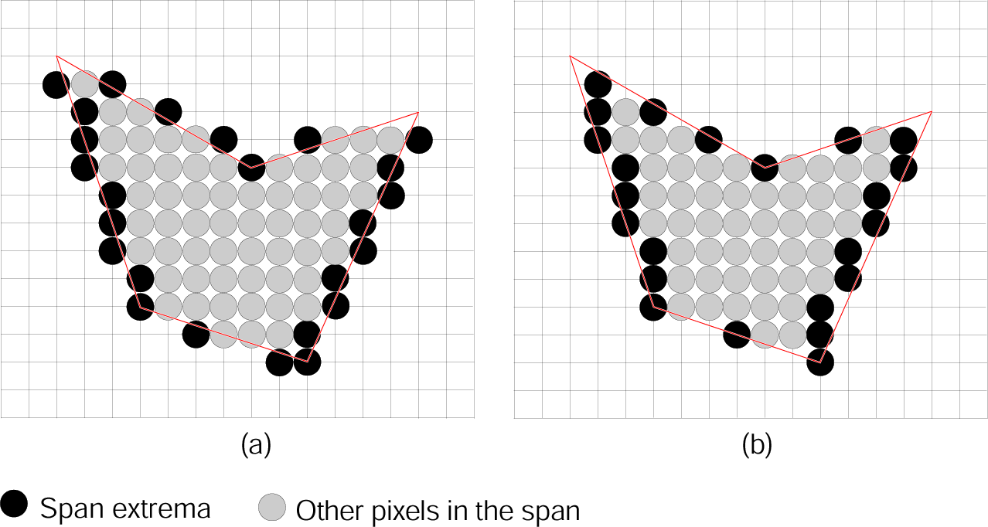
Scan Filling Polygons
Idea #1: use midpoint algo on each edge, fill in between extrema points
Note: many extrema pixels lie outside the polygon
Why: midpoint algo has no sense of in/out
1994 Foley/VanDam/Finer/Huges/Phillips ICG

Slide 31
Scan Filling Polygons
Idea #2: draw pixels only strictly inside
  Find intersections of
  scan line with edges
  Sort intersections by
  increasing x coordinate
  Fill pixels on inside
  based on a parity bit
    B_{p} initially even (off)
    Invert at each intersect
    Draw with odd,
    do not draw when even
1994 Foley/VanDam/Finer/Huges/Phillips ICG

Slide 32
Scan Filling Polygons
Issues with Idea #2:
  If at a fractional x value, how to pick which pixels are in interior?
  Intersections at integer vertex coordinates?
  Shared vertices?
  Vertices that define a horizontal edge?

Slide 33
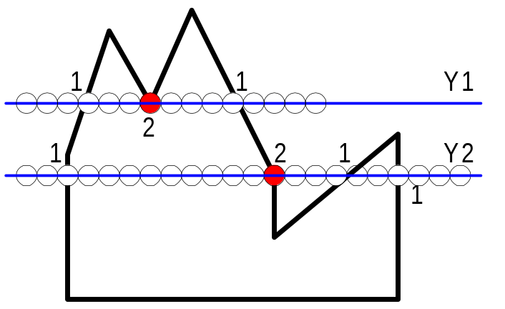

How to handle vertices?
Problem:
  vertices are counted twice
Solution:
  If both neighboring vertices are on the same side of the scan line, don’t count it
  If both neighboring vertices are on different sides of a scan line, count it once
  Compare current y value with y value of neighboring vertices

Slide 34
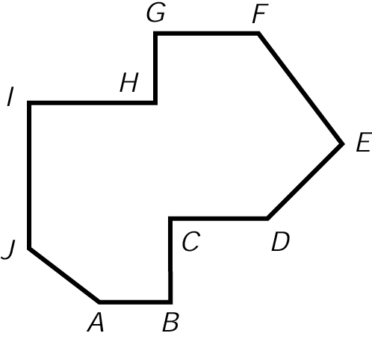
How to handle horizontal edges?
Idea: don’t count their vertices
Apply open and closed status to vertices to other edges
  y_{min} vertex closed
  y_{max} vertex is open
On AB, A is at y_{min} for JA; AB does not contribute, B_{p} is odd and draw AB
Edge BC has y_{min} at B, but AB does not contribute, B_{p} becomes even and drawing stops
1994 Foley/VanDam/Finer/Huges/Phillips ICG

Slide 35
How to handle horizontal edges?
Start drawing at IJ (B_{p} becomes odd).
C is y_{max} (open) for BC. B_{p} doesn’t change.
Ignore CD. D is y_{min} (closed) for DE. B_{p} becomes even. Stop drawing.
I is y_{max} (open) for IJ. No drawing.
Ignore IH. H is y_{min} (closed) for GH. B_{p} becomes odd. Draw to FE.
Ignore GF. No drawing
1994 Foley/VanDam/Finer/Huges/Phillips ICG

Slide 36
Polygon Filling Algorithm
Create a list for each scan-line y with the polygon edges that intersect the scan-line
  For each edge, examine y_{min} and y_{max}
  If edge is horizontal, ignore it
  If y_{max} on scan-line, ignore it
  If y_{min} <= y < y_{max} add edge to scan-line list
For each scan-line
  Calculate intersections with edges on list
  Sort intersections in x
Perform parity-bit scan-line filling
  Check for double intersection special case
This also solves overlapping vertex problem

Slide 37
Polygon Filling Algorithm
For each polygon
  For each edge, mark each scan-line that the edge crosses by examining its y_{min} and y_{max}
    If edge is horizontal, ignore it
    If y_{max} on scan-line, ignore it
    If y_{min} <= y < y_{max} add edge to scan-line y‘s edge list
  For each scan-line between polygon’s y_{min} and y_{max}
    Calculate intersections with edges on list
    Sort intersections in x
    Perform parity-bit scan-line filling
    Check for double intersection special case
  Clear scan-lines’ edge list

Slide 38
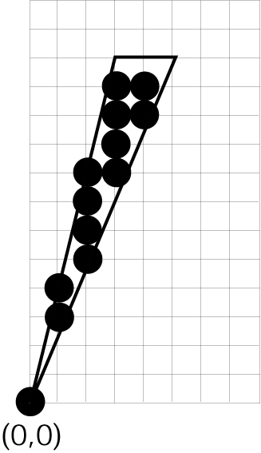
How to handle slivers?
When the scan area does not have an “interior”
Solution: use anti-aliasing
But, to do so will require softening the rules about drawing only interior pixels
1994 Foley/VanDam/Finer/Huges/Phillips ICG

Slide 39

Scan-Filling a Polygon
Animated by Max Peysakhov @ Drexel University

Slide 40
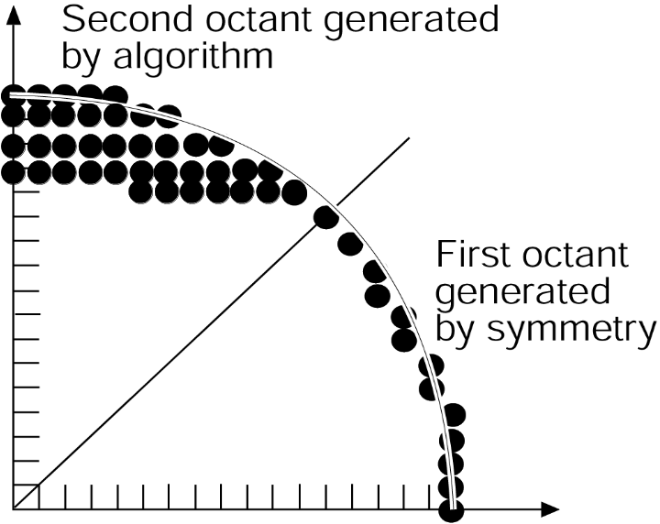
Scan Filling Curved Objects
Hard in general case
Easier for circles and ellipses.
Use midpoint Alg to generate boundary points.
Fill in horizontal pixel spans
Use symmetry
1994 Foley/VanDam/Finer/Huges/Phillips ICG

Slide 41
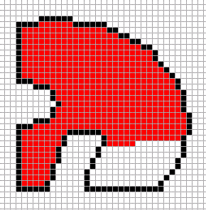
Boundary-Fill Algorithm
Start with some internal point (x,y)
Color it
Check neighbors for filled or border color
Color neighbors if OK
Continue recursively

Slide 42
4 Connected Boundary-Fill Alg
Void BoundaryFill4( int x, int y, int fill, int bnd)
{
  If Color(x,y) != fill and Color(x,y) != bnd
  {
  SetColor(x,y) = fill;
  BoundaryFill4(x+1, y, fill, bnd);
  BoundaryFill4(x, y +1, fill, bnd);
  BoundaryFill4(x-1, y, fill, bnd);
  BoundaryFill4(x, y -1, fill, bnd);
  }
}

Slide 43
Boundary-Fill Algorithm
Issues with recursive boundary-fill algorithm:
  May make mistakes if parts of the space already filled with the Fill color
  Requires very big stack size
More efficient algorithms
  First color contiguous span along one scan line
  Only stack beginning positions of neighboring scan lines
1994 Foley/VanDam/Finer/Huges/Phillips ICG

Slide 44
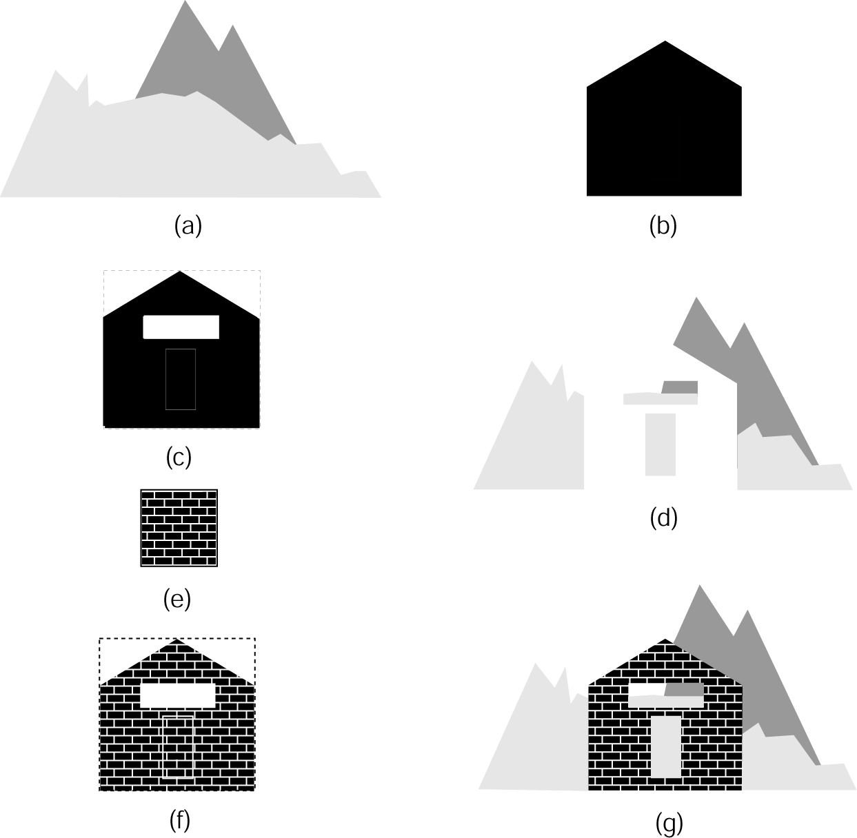
Pattern Filling
Via Scan Conversion
  Copy pixel in pattern template to location in polygon
  The entire screen is ‘tiled’
  and the polygon is a window
Without Scan Conversion
  Create patterned template in a rectangular work area (off the screen)
  Copy this template as needed
Handle overwrites with
masking
1994 Foley/VanDam/Finer/Huges/Phillips ICG

Slide 45
Course Status
So far everything straight lines!
How to model 2D curved objects?
  Representation
    Circles
    Types of 2D Curves
    Parametric Cubic Curves
    Bézier Curves, (non)uniform, (non)rational
    NURBS
  Drawing of 2D Curves
    Line drawing algorithms for complex curves
    DeCasteljeau, Subdivision, De Boor

Slide 46
Homework #2
Modify homework #1
Add “moveto” and “lineto” commands
They define closed polygons
Clip polygons against window with Sutherland-Hodgman algorithm
Display edges with HW1 line-drawing code

